Slide 1
Introduction to transformers
Peyman Tahghighi
Winter 2024

Slide 2
Learning objectives
Why do we need an attention mechanism?
How does attention work?
What are encoders and decoders in transformers?
Vision transformers.

Slide 3
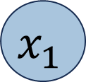
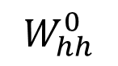
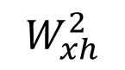
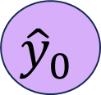
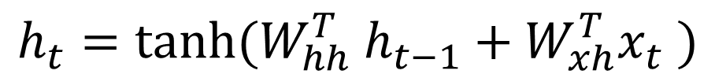
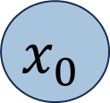

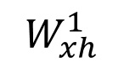
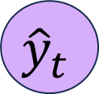
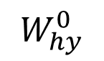
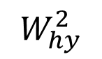
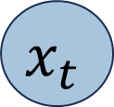
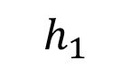
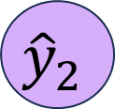
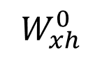
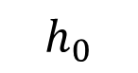
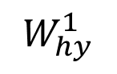
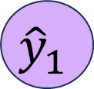
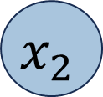
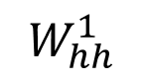
Recurrent Neural Networks
$${\hat{y}}_{t}$$
$${\hat{y}}_{0}$$
$${\hat{y}}_{1}$$
$${\hat{y}}_{2}$$
$$W_{hy}^{0}$$
$$W_{hy}^{1}$$
$$W_{hy}^{2}$$
Recurrent call
Recurrent call
$$h_{0}$$
Recurrent call
$$h_{1}$$
Recurrent call
$$W_{hh}^{0}$$
$$W_{hh}^{1}$$
$$W_{xh}^{0}$$
$$W_{xh}^{1}$$
$$W_{xh}^{2}$$
$$x_{t}$$
$$x_{0}$$
$$x_{1}$$
$$x_{2}$$
Output vector
Hidden state update
$${\hat{y}}_{t}=W_{hy}^{T}h_{t}$$
$$h_{t}=tanh⁡(W_{hh}^{T} h_{t−1}+W_{xh}^{T}x_{t} )$$

Slide 4
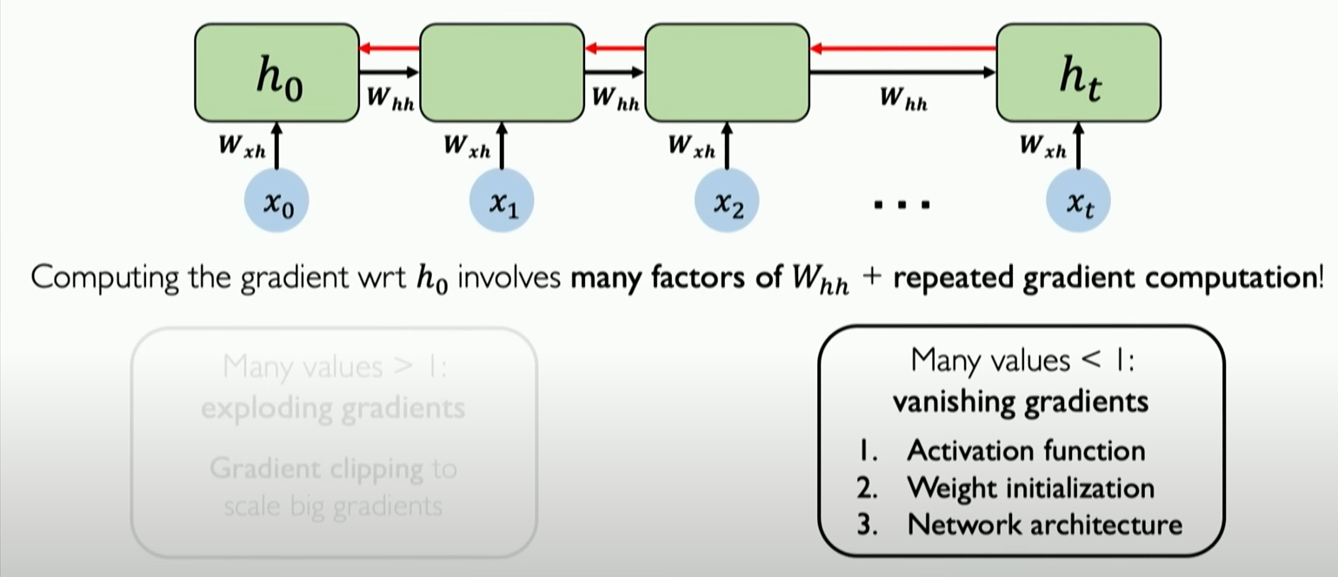
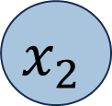
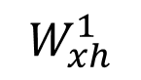
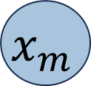

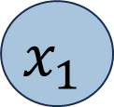
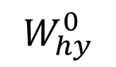
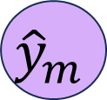
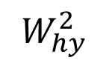
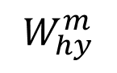

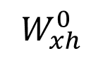
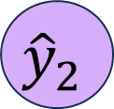
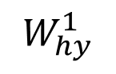
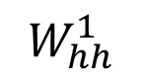
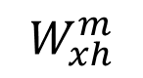

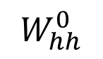
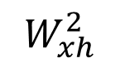
Recurrent Neural Networks
$${\hat{y}}_{0}$$
$${\hat{y}}_{1}$$
$${\hat{y}}_{2}$$
$${\hat{y}}_{m}$$
$$W_{hy}^{0}$$
$$W_{hy}^{1}$$
$$W_{hy}^{2}$$
$$W_{hy}^{m}$$
Recurrent call
Recurrent call
Recurrent call
Recurrent call
$$W_{hh}^{0}$$
$$W_{hh}^{1}$$
$$W_{xh}^{0}$$
$$W_{xh}^{1}$$
$$W_{xh}^{2}$$
$$W_{xh}^{m}$$
$$x_{0}$$
$$x_{1}$$
$$x_{2}$$
$$x_{m}$$
Many values > 1:
Exploding gradients
Many values < 1:
Vanishing gradients

Slide 5
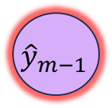


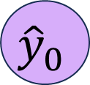
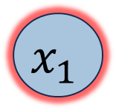
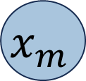
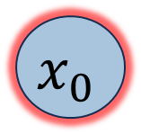
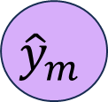

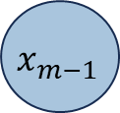
Recurrent Neural Networks
I grew up in France…. And I speak fluent….
$${\hat{y}}_{0}$$
$${\hat{y}}_{1}$$
$${\hat{y}}_{2}$$
$${\hat{y}}_{m−1}$$
$${\hat{y}}_{m}$$
Recurrent call
Recurrent call
Recurrent call
Recurrent call
Recurrent call
$$x_{0}$$
$$x_{1}$$
$$x_{2}$$
$$x_{m−1}$$
$$x_{m}$$

Slide 6
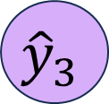
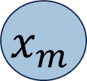
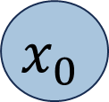
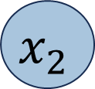
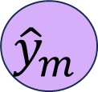
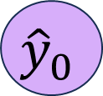
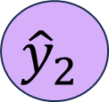
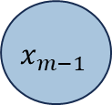




Goal of Sequence Modeling
$${\hat{y}}_{0}$$
$${\hat{y}}_{1}$$
$${\hat{y}}_{2}$$
$${\hat{y}}_{3}$$
$${\hat{y}}_{m−1}$$
$${\hat{y}}_{m}$$
Limitations of RNN:
Weak Long- Term Memory.
Vanishing/Exploding Gradients.
Not easy to parallelize.
$$x_{0}$$
$$x_{1}$$
$$x_{2}$$
$$x_{3}$$
$$x_{m−1}$$
$$x_{m}$$

Slide 7
Goal of Sequence Modeling
Feed Everything in a dense network:
No Recurrence
Not scalable
No order
Concatenated list of features
$x_{0}$ ${ x}_{1}$ ${ x}_{2}{ x}_{3}$ ${ x}_{4}$ ${ x}_{m−1}{ x}_{m}$

Slide 8


Attention, the core of transformers
Identify which parts to attend to
Extract the features with higher attention
Notes:
First step is to find and understand what parts are important, we attend to parts that are relevant and important for the task at hand

Slide 9

What is attention?
Key (K₁)
Key (K₂)
Value (V)
Key (K₃)
1.Attention mask: How similar each key is to the query?
2.Extract values based on attention: Return a combination of values according to the mask.

Slide 10

Self-attention
He
tossed
the
tennis
ball
to
serve
1- Encode positional information
Positional encoding
Notes:
Dot product represent the similarity

Slide 11

Self-attention
1- Encode positional information
2-Extract Key, Query and Value
Q
Query
K
Key
V
Value

Slide 12
Self-attention
1- Encode positional information
2-Extract Key, Query and Value
3-Compute attention weights
4-Extract features with high attention
tossed
Q
tossed
tennis
tennis
serve
He
serve
He
ball
the
ball
the
to
K^{T}
to
He
He
tossed
Q . K^{T}
tossed
the
the
Softmax(
)
tennis
scalling
tennis
ball
ball
to
to
serve
serve
V
Final attention

Slide 13
Recap
MatMul
1- Encode positional information
2-Extract Key, Query and Value
3-Compute attention weights
4-Extract features with high attention
Softmax
Scale
MatMul
Query
Key
Value
Linear
Linear
Linear

Slide 14

Multiheaded attention
Multiple parallel attention computation
Helps with extracting diverse features

Slide 15

Encoder bigger picture
x + atten(x) is important for:
Gradient flow
Preserving information

Slide 16
Decoder bigger picture

Slide 17
Transformers
Cross attention
Q -> Input
K, V -> Conditional information
K
V
Q

Slide 18

Transformers Decoder

Slide 19

Vision transformers
Happening through CNN

Slide 20

Vision transformers

Slide 21
Summary
How attention mechanism solve challenges of RNNs.
What are key, query and value mean in attention and how to calculate attention masks.
Encoder and decoder.
Vision transformers.

Slide 22
Useful resources
https://www.youtube.com/watch?v=ySEx_Bqxvvo&ab_channel=AlexanderAmini
https://www.youtube.com/watch?v=kCc8FmEb1nY&pp=ygUIa2FycGF0aHk%3D
https://www.youtube.com/watch?v=OyFJWRnt_AY&t=3634s&pp=ygUOcGFzY2FsIHBvdXBhcnQ%3D

